Slide 1
EGYPT, GREEK, RENAISSANCE ARCHITECTURE
UNIT II

Slide 2
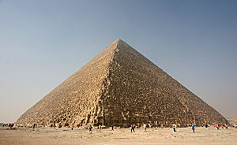
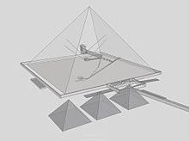
PYRAMID OF GIZA, EGYPT, 2560 B.C.
The Great Pyramid of Giza (also known as the Pyramid of Khufu or the Pyramid of Cheops)
oldest and largest Seven wonders of the ancient world
only one to remain largely intact.
built as a tomb over a 10 to 20-year period concluding around 2560 BC.
Initially at 146.5 metres (481 feet) tallest man made structure in the world for over 3,800 years.
Originally, the covered by casing stones formed a smooth outer surface
seen today underlying core structure.
varying scientific and alternative theories Of construction hypotheses
built by moving huge stones from a quarry dragging and lifting them into place.
three known chambers inside.
lowest chamber cut into bedrock.
Queen's Chamber and King's Chamber higher up.
only pyramid to contain both ascending and descending passages.
includes two mortuary temples in honour of Khufu
three smaller pyramids for Khufu's wives
smaller "satellite" pyramid
raised causeway connecting the two temples
small surrounding mastaba tombs
casing stones and inner chamber blocks of the Great Pyramid fit together with extremely high precision. opening of the joints is only 0.5 millimetres wide (1/50th of an inch).
Transparent view of Khufu's pyramid from SE. Taken from a 3d Model

Slide 3
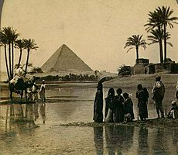
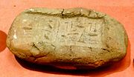
PYRAMID OF GIZA, EGYPT, 5000 B.C.
four sides of the base average error of only 58 millimetres. base is horizontal and flat to within ±15 mm (0.6 in).The sides of the square base closely aligned to the four cardinal compass points based on true north not magnetic north
Construction theory:
contradictory theories proposed regarding the pyramid's construction techniques.
Many disagree the blocks were dragged, lifted, or even rolled
modern discoveries suggest built by tens of thousands of skilled workers, not slaves.
mystery of the pyramid's construction → planning.
laying out parts of the plan on the ground at a 1-to-1 scale.
precision unmatched by any other means.
14-year time span for construction.
peak workforce of 40,000.
Clay seal bearing the name of Khufu from the great pyramid. On display at the Louvre museum, Paris

Slide 4
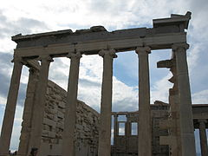
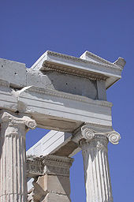
ERECTHEION, ATHENS, GREECE
built between 421 and 406 BC in honour of legendary king Erectheus, mentioned in Homer's Iliad as a great king and ruler
Complex design to preserve multiple adjacent sacred precincts
main structure consists of four compartments, largest east cella & Ionic portico in east end.
entire interior at lower level and East porch used for access to great altar via balcony
stair also a public viewing platform.
entire temple on a slope
west and north sides 3 m (9 ft) lower than the south and east sides.
built entirely of marble
friezes of black limestone bore sculptures executed in relief in white marble.
elaborately carved doorways and windows columns ornately decorated painted, gilded and highlighted with gilt bronze & multi-coloured inset glass beads.
ancient Greek temple on the north side of the Acropolis of Athens in Greece
built to conceal giant 15-ft beam needed to support the southwest corner, building drastically reduced in size and budget following the great war
The Porch of the Caryatids
north side, large porch with six Ionic columns, south, famous "Porch of the Maidens“ → six draped female figures (caryatids) supporting columns.

Slide 5
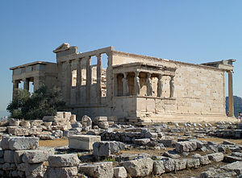
ERECTHEION, ATHENS, GREECE
Religious functions
According to the myth, Athena's sacred snake lived there.
The snake was fed honey-cakes by the priestesses of Athena by custom the women of the ancient family
The snake's occasional refusal to eat the cakes was thought a disastrous omen.
Late antiquity and the Middle Ages
The restoration of Erechtheion received the Europa Nostra Award.
underwent extensive repairs and reformation for the first time during the 1st century B.C., after its catastrophic burning by the Roman general Sulla.
building was altered decisively during early Byzantine period, transformed into a church. Alteration→ many architectural features of the ancient construction were lost
so knowledge of the interior arrangement of the building is limited.
It became a palace residence of the Turkish commander's harem in the Ottoman period.
Modern times
In 1801 one of the caryatids and the north column of the east porch together with the overlying section of the entablature removed by Lord Elgin to decorate his Scottish mansion,
later sold to the British museum(along with the pediment and frieze sculpture taken from the Parthenon).
Athenian legend → at night the remaining five Caryatids could be heard wailing for their lost sister.
1979, five original Caryatids replaced in situ by exact replicas. 2005 to repair the damage using laser cleaning.

Slide 6
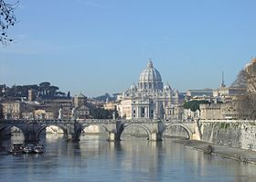
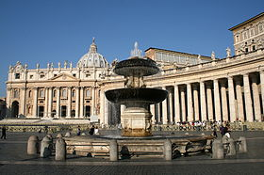
ST.PETERS BASILICA, ROME
St. Peter's Basilica from ponte Umberto I, on River Tiber. The iconic dome dominates the skyline of Rome
St. Peter's Basilica Late Renaissance church located within Vatican city.
Designed principally by Donato Bramante, Michelangelo, Carlo Maderno and
Gian Lorenzo Bernini
St. Peter's→ most renowned work of Renaissance architecture
one of the largest churches in the world.,
holiest Catholic sites.
burial site of Saint Peter, one of the twelve apostles of Jesus and, also according to tradition, the first Bishop of Rome and therefore first in the line of the papal succession.
many strong historical associations
Early Christian church, the papacy, the Protestant Reformation and Counter-reformation, numerous artists, most significantly Michelangelo.
As a work of architecture, it is regarded as the greatest building of its age.
St Peter's, Bernini's colonnade and Maderno's fountain
The basilica is approached via St. Peter's Square, a forecourt in two sections, both surrounded by tall colonnades. The first space is oval and the second trapezoid.
church in the Renaissance style located in the Vatican City west of the River Tiber.
Its central dome dominates the skyline of Rome.

Slide 7
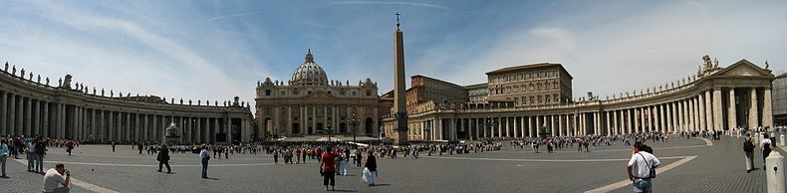
ST.PETERS BASILICA, ROME
Interior lavishly decorated with marble, reliefs, architectural sculpture and gilding.
Contains large number of tombs of popes and other notable people, considered outstanding artworks.
number of sculptures in niches and chapels, including Michelangelo's Pietà.
central feature is a baldachin, or canopy over the Papal Altar, designed by Gian Lorenzo Bernini. sanctuary culminates in a sculptural ensemble, also by Bernini, and
containing the symbolic Chair of Saint Peter.
Interior→ vast dimensions.
As people draw near to monument, strangely they appear to shrink; they are, dwarfed by the scale of everything in the building.
Nave leads to central dome in three bays, piers supporting barrel-vault, the highest of any church.
Nave framed by wide aisles which have a number of chapels off them. also chapels surrounding dome.
heart of the basilica, beneath high altar, is Chapel of the Confession,
Two curving marble staircases lead to this underground chapel at the level of the Constantine church and immediately above the burial place of Saint Peter.
One observer wrote: "St Peter's Basilica is the reason why Rome is still the center of the civilized world. For religious, historical, and architectural reasons it by itself justifies a journey to Rome, and its interior offers a palimpsest of artistic styles at their best..."
The façade of the basilica, with a giant order of columns, stretches across the end of the square and is approached by steps on which stand two 5.55 metres (18.2 ft) statues of the 1st century apostles to Rome, Saints Peter and Paul
The basilica is cruciform in shape, with an elongated nave in the LATIN CROSS form but the early designs were for a centrally planned structure and this is still in evidence in the architecture. The central space is dominated both externally and internally by one of the largest domes in the world. The entrance is through a narthex, or entrance hall, which stretches across the building.

Slide 8
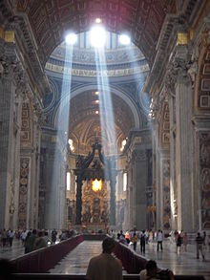
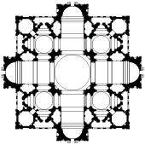
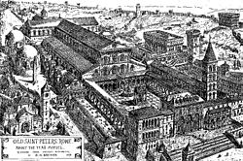
ST.PETERS BASILICA, ROME
Pope Julius' scheme for the grandest building in Christendom^{[6]} was the subject of a competition for which a number of entries remain intact in the Uffizi Gallery, Florence. It was the design of Donato Bramante that was selected, and for which the foundation stone was laid in 1506. This plan was in the form of an enormous Greek Cross with a dome inspired by that of the huge circular Roman temple, the Pantheon.^{[6]} The main difference between Bramante's design and that of the Pantheon is that where the dome of the Pantheon is supported by a continuous wall, that of the new basilica was to be supported only on four large piers. This feature was maintained in the ultimate design. Bramante's dome was to be surmounted by a lantern with its own small dome but otherwise very similar in form to the Early Renaissance lantern of Florence Cathedral designed for Brunelleschi's dome by Michelozzo.^{[25]}
Bramante had envisioned that the central dome be surrounded by four lower domes at the diagonal axes. The equal chancel, nave and transept arms were each to be of two bays ending in an apse. At each corner of the building was to stand a tower, so that the overall plan was square, with the apses projecting at the cardinal points. Each apse had two
large radial buttresses, which squared off its semi-circular shape.^{[26]}
When Pope Julius died in 1513, Bramante was replaced with Giuliano da Sangallo, Fra Giocondo and Raphael. Sangallo and Fra Giocondo both died in 1515, Bramante himself having died the previous year. The main change in Raphael's plan is the nave of five bays, with a row of complex apsidal chapels off the aisles on either side. Raphael's plan for the chancel and transepts made the squareness of the exterior walls more definite by reducing the size of the towers, and the semi-circular apses more clearly defined by encircling each with an ambulatory.^{[27]}
Bramante design
Plan=enormous Greek cross
dome- inspired by huge circular roman temple pantheon
pantheon dome supported by circular wall,
here supported by 4 large piers
dome surmounted by lantern like Florence cathedral
central dome surrounded by 4 lower domes in diagonal axes
equal arms 2bays ending in apse
tower in each corner
overall building square
each apse had two large radial buttresses
that squared off its semi circular shape
Bramante design
Raphael’s plan: The main change→ nave of five bays, row of complex apsidal chapels off the aisles on either side.
made the squareness of the exterior walls more definite
reducing the size of the towers, encircling each apses with an ambulatory.
Peruzzi, Raphael’s successor reverted to Greek cross plan never realised his building as Rome was plundered in the war

Slide 9
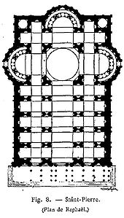
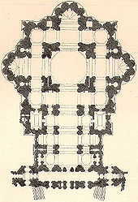
ST.PETERS BASILICA, ROME
Michelangelo's contribution
Michelangelo took over when four piers, enormous beyond any constructed since ancient Roman times, were rising behind the remaining nave of the old basilica.
reverted to the Greek Cross and, converted its snowflake complexity into massive, cohesive unity.
extended with a nave by Carlo Maderno. chancel end (the ecclesiastical "Eastern end") huge
centrally placed dome work of Michelangelo. projection of the nave screens the dome from sight when the building is approached from the square in front of it,
best appreciated from a distance.
blurred the definition of the geometry by making external masonry of massive proportions and filling in every corner with a small vestry or stairwell.
effect created is continuous wall-surface folded or fractured at different angles, but lacks the right-angles
exterior is surrounded by a giant order of Corinthian pilasters
Michelangelo's plan, extended with Maderno's nave and façade
Raphael's plan
all set at slightly different angles to each other,
in keeping with the ever-changing angles of the wall's surface.
Above them the huge cornice ripples in a continuous band, giving the appearance of keeping the whole building in a state of compression
Succeeded by Sangallo

Slide 10
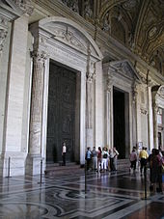
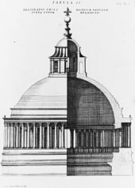
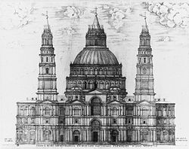
ST.PETERS BASILICA, VATICAN CITY, ROME
The narthex
Bramante's dome
Bramante's dome
The dome of St. Peter's rises to a total height of 136.57 metres (448.1 ft) from the floor of the basilica to the top of the external cross. It is the tallest dome in the world. Its internal diameter is 41.47 metres (136.1 ft), slightly smaller than two of the three other huge domes that preceded it, those of the Pantheon of Ancient Rome, 43.3 metres (142 ft), and Florence Cathedral of the Early Renaissance, 44 metres (144 ft). It has a greater diameter by approximately 30 feet (9.1 m) than Constantinople's Hagia Sophia church, completed in 537. It was to the domes of the Pantheon and Florence duomo that the architects of St. Peter's looked for solutions as to how to go about building what was conceived, from the outset, as the greatest dome of Christendom.
Bramante and Sangallo, 1506 and 1513
The dome of the Pantheon stands on a circular wall with no entrances or windows except a single door. The whole building is as high as it is wide. Its dome is constructed in a single shell of concrete, made light by the inclusion of a large amount of the volcanic stones tuff and pumice. The inner surface of the dome is deeply coffered which has the effect of creating both vertical and horizontal ribs, while lightening the overall load. At the summit is an ocular opening 8 metres (26 ft) across which provides light to the interior.
Bramante's plan for the dome of St. Peter's (1506) follows that of the Pantheon very closely, and like that of the Pantheon, was designed to be constructed in tufa concrete for which he had rediscovered a formula. With the exception of the lantern that surmounts it, the profile is very similar, except that in this case the supporting wall becomes a drum raised high above ground level on four massive piers. The solid wall, as used at the Pantheon, is lightened at St. Peter's by Bramante piercing it with windows and encircling it with a peristyle.
Sangallo's design
In the case of Florence Cathedral, the desired
visual appearance of the pointed dome existed for many years before Brunelleschi made its construction feasible.Its double-shell construction of bricks locked together in herringbone pattern (re-introduced from Byzantine architecture), and the gentle upward slope of its eight stone ribs made it possible for the construction to take place without the massive wooden formwork necessary to construct hemispherical arches. While its appearance, with the exception of the details of the lantern, is entirely Gothic, its engineering was highly innovative, and the product of a mind that had studied the huge vaults and remaining dome of Ancient Rome.

Slide 11
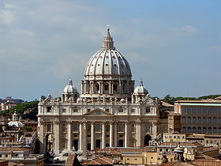
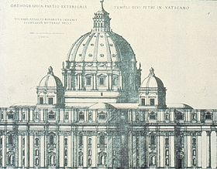
ST.PETERS BASILICA, VATICAN CITY, ROME
Michelangelo redesigned the dome in 1547, taking into account all that had gone before. His dome, like that of Florence, is constructed of two shells of brick, the outer one having 16 stone ribs, twice the number at Florence but far fewer than in Sangallo's design. As with the designs of Bramante and Sangallo, the dome is raised from the piers on a drum. The encircling peristyle of Bramante and the arcade of Sangallo are reduced to 16 pairs of Corinthian columns, each of 15 metres (49 ft) high which stand proud of the building, connected by an arch. Visually they appear to buttress each of the ribs, but structurally they are probably quite redundant. The reason for this is that the dome is ovoid in shape, rising steeply as does the dome of Florence Cathedral, and therefore exerting less outward thrust than does a hemispherical dome, such as that of the Pantheon, which, although it is not buttressed, is countered by the downward thrust of heavy masonry which extends above the circling wall.
The ovoid profile of the dome has been the subject of much speculation and scholarship over the past century. Michelangelo died in 1564, leaving the drum of the dome complete, and Bramante's piers much bulkier than originally designed, each 18 metres (59 ft) across. Following his death, the work continued under his assistant Jacopo Barozzi da Vignola with Giorgio Vasari appointed by Pope Pius V as a watchdog to make sure that Michelangelo's plans were carried out exactly. Despite Vignola's knowledge of Michelangelo's intentions, little
happened in this period. In 1585 the energetic Pope Sixtus appointed Giacomo della Porta who was to be assisted by Domenico Fontana. The five-year reign of Sixtus was to see the building advance at a great rate.
St. Peter's Basilica from Castel Sant'Angelo showing the dome rising behind Maderno's façade.
The engraving by Stefan du Pérac was published in 1569, five years after the death of Michelangelo
Michelangelo left a few drawings, including an early drawing of the dome, and some drawings of details. There were also detailed engravings published in 1569 by Stefan du Pérac who claimed that they were the master's final solution. Michelangelo, like Sangallo before him, also left a large wooden model. Giacomo della Porta subsequently altered this model in several ways, in keeping with changes that he made to the design. Most of these changes were of a cosmetic nature, such as the adding of lion's masks over the swags on the drum in honour of Pope Sixtus and adding a circlet of finials around the spire at the top of the lantern, as proposed by Sangallo. The major change that was made to the model, either by della Porta, or Michelangelo himself before his death, was to raise the outer dome higher above the inner one.

Slide 12
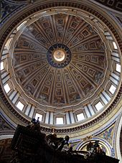
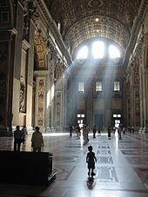
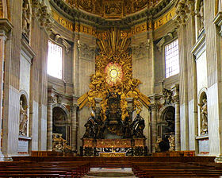
ST.PETERS BASILICA, VATICAN CITY, ROME
The dome was brought to completion by Giacomo della Porta and Fontana.
A drawing by Michelangelo indicates that his early intentions were towards an ovoid dome, rather than a hemispherical one. In an engraving in Galasso Alghisi' treatise (1563), the dome may be represented as ovoid, but the perspective is ambiguous. Stefan du Pérac's engraving (1569) shows a hemispherical dome, but this was perhaps an inaccuracy of the engraver. The profile of the wooden model is more ovoid than that of the engravings, but less so than the finished product. It has been suggested that Michelangelo on his death bed reverted to the more pointed shape. However Lees-Milne cites Giacomo della Porta as taking full responsibility for the change and as indicating to Pope Sixtus that Michelangelo was lacking in the scientific understanding of which he himself was capable.
Helen Gardner suggests that Michelangelo made the change to the hemispherical dome of lower profile in order to establish a balance between the dynamic vertical elements of the encircling giant order of pilasters and a more static and reposeful dome. Gardner also comments "The sculpturing of architecture [by Michelangelo]... here extends itself up from the ground through the attic stories and moves on into the drum and dome, the whole building being pulled together into a unity from base to summit.“
It is this sense of the building being sculptured, unified and "pulled together" by the encircling band of the deep cornice that led Eneide Mignacca to conclude that the ovoid profile, seen now in the end product, was an essential part of Michelangelo's first (and last) concept. The sculptor/architect has, figuratively speaking, taken all the previous designs in hand and compressed their contours as if the building were a lump of clay. The dome must appear to thrust upwards because of the apparent pressure created by flattening the building's angles and restraining its projections. If this explanation is the correct one, then the profile of the dome is not merely a structural solution, as perceived by Giacomo della Porta; it is part of the integrated design solution that is about visual tension and compression. In one sense, Michelangelo's dome may appear to look backward to the Gothic profile of Florence Cathedral and ignore the Classicism of the Renaissance, but on the other hand, perhaps more than any other building of the 16th century, it prefigures the architecture of the Baroque.
Sangallo's plan (1513), of which a large wooden model still exists, looks to both these predecessors. He realised the value of both the coffering at the Pantheon and the outer stone ribs at Florence Cathedral. He strengthened and extended the peristyle of Bramante into a series of arched and ordered openings around the base, with a second such arcade set back in a tier above the first. In his hands, the rather delicate form of the lantern, based closely on that in Florence, became a massive structure, surrounded by a projecting base, a peristyle and surmounted by a spire of conic form.
The apse with St. Peter's Cathedra supported by four Doctors of the Church

Slide 13
